Slide 1
Kickstarting Success
A Focus on:
PROBABILITY
PROFITABILITY
POPULARITY
GEARED TOWARDS:
TECHNOLOGY
DESIGN
GAMES

Slide 2
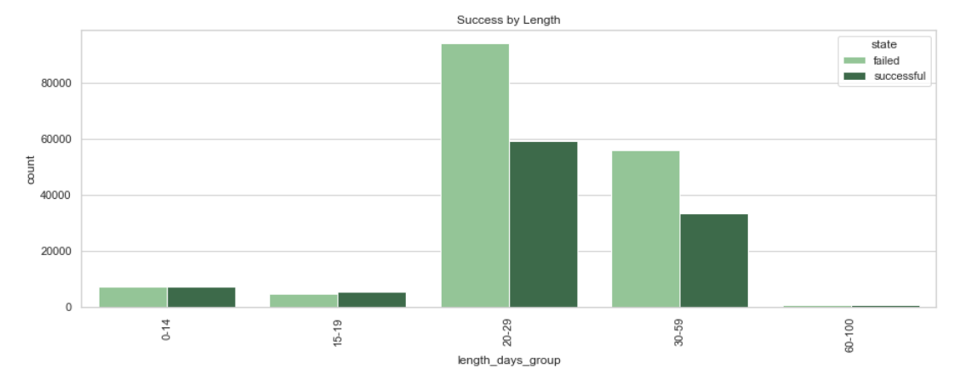
Successful Campaigns: Length
Average 31 days

Slide 3
7.2% Key CAMPAIGN Length: 20-29 days
An increase of one backer for a campaign with a length between 20 and 29 days increases its chances of success by 7.2%
Otherwise, chances of success increase by 2% - 6%.

Slide 4
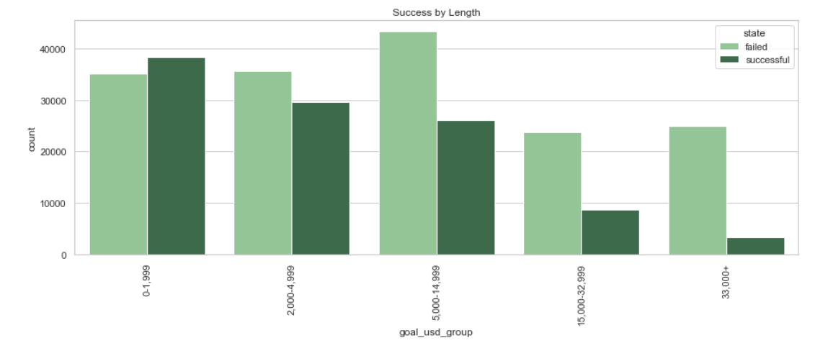
Successful Campaigns: Goal
 | Average Goal in USD
Successful | $7,128
Unsuccessful | $19,917
Less is more (likely)!

Slide 5
5.8% Key CAMPAIGN Goal: $5,000 - $15,000
An increase of one backer for a campaign with a goal between 5,000 and 15,000 USD increases its chances of success by 5.8%
Otherwise, chances of success increase by 3% - 4%.

Slide 6
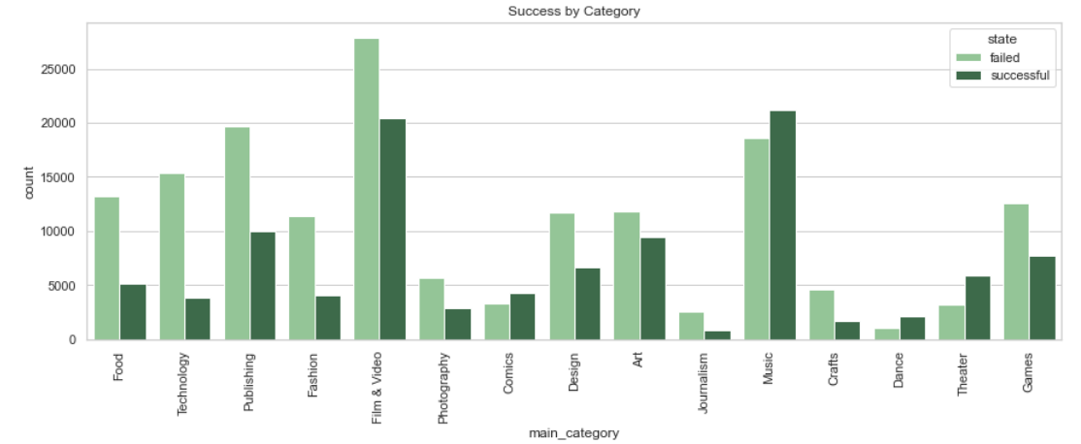
PROBABILITY of success per category
42%
53%
20%
36%
38%
65%
56%

Slide 7
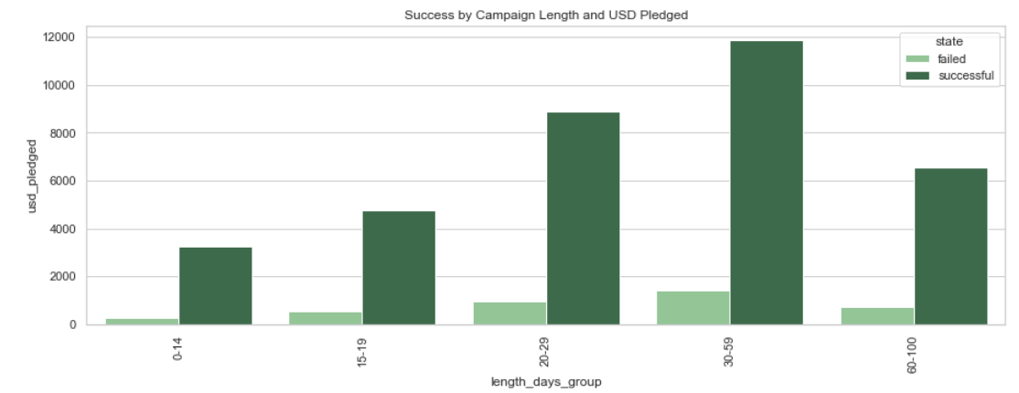
Profitability OF SUCCESSFUL campaigns
INCREASE BETWEEN 20 AND 59 DAYS

Slide 8
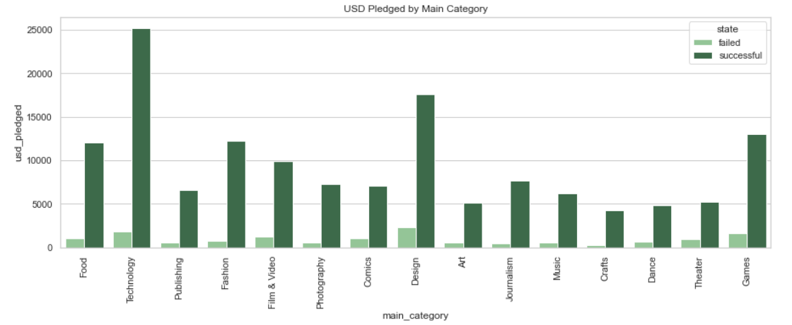
Profitability OF SUCCESSFUL campaigns
INCREASE IN TECHNOLOGY, DESIGN, GAMES CATEGORIES

Slide 9
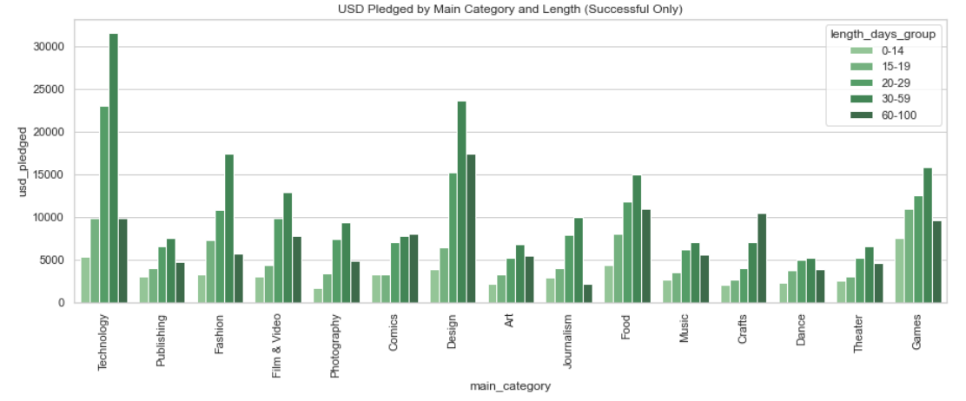
Profitability OF SUCCESSFUL campaigns
USD Pledged for TECHNOLOGY, DESIGN, GAMES between 20 and 59 days

Slide 10
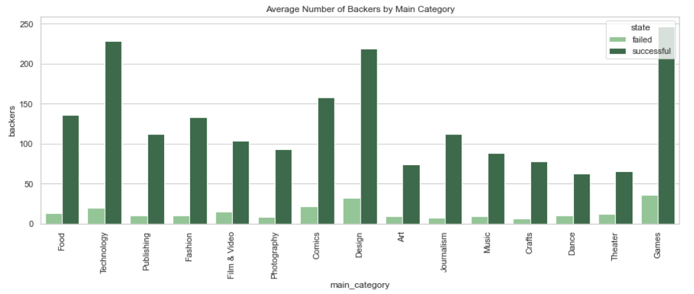
PopularITY OF SUCCESSFUL campaigns
Most popular are TECHNOLOGY, DESIGN, GAMES
228
247
219
158
103

Slide 11
Expected USD PLEDGED per main category: HIGH
 | Chance of success | Average amount raised per successful campaign | Expected amount raised per campaign (USD)
Technology | 20% | $25,197 | $5,039
Design | 36% | $17,545 | $6,316
Games | 38% | $12,980 | $4,932
Film & Video | 42% | $9,916 | $4,165
Comics | 56% | $7,036 | $3,940

Slide 12
Expected USD PLEDGED per main category: LOW
 | Chance of success | Average amount raised per successful campaign | Expected amount raised per campaign (USD)
Crafts | 26% | $4,259 | $1,107
Journalism | 24% | $7,675 | $1,842
Fashion | 26% | $12,240 | $3,132

Slide 13
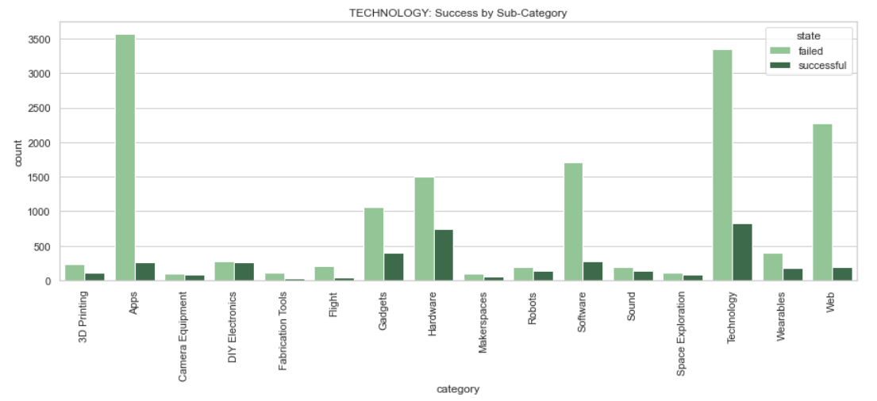
3.5% Key category: Technology
43%
32%
45%
43%
Expected $ raised:
9,436
6,390
9,665
9,876
An increase of one backer in the technology category increases a project’s chances of success by 3.5%.

Slide 14
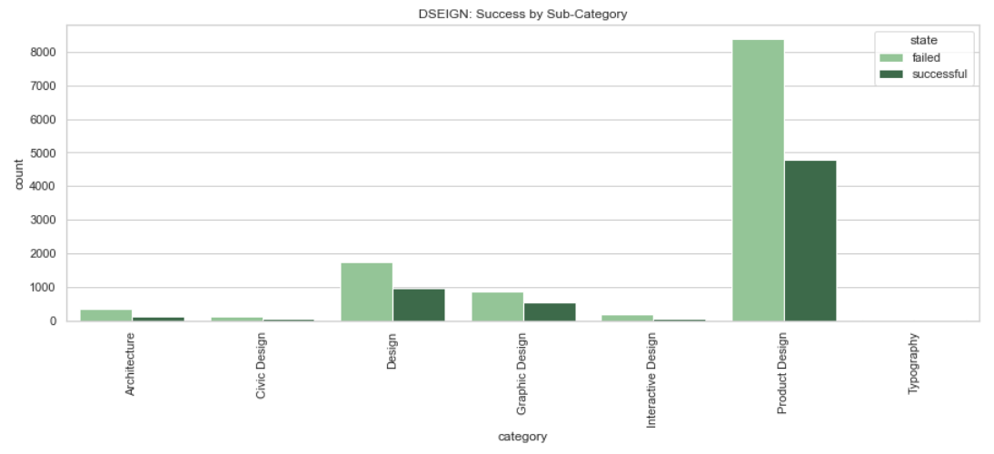
3.0% Key category: DESIGN
36%
36%
Expected $ raised:
$3,006
$4,579
An increase of one backer in the design category increases a project’s chances of success by 3.0%.

Slide 15
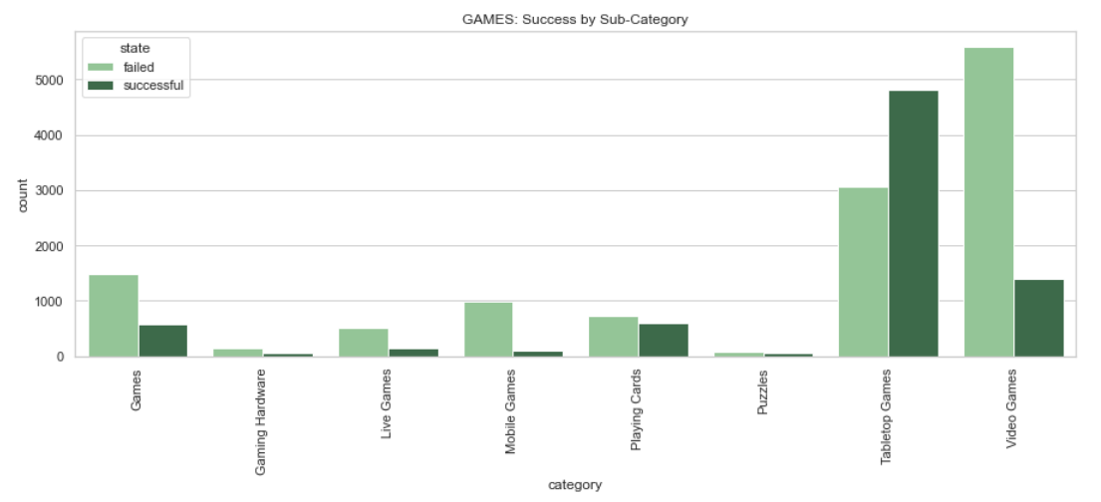
3.0% Key category: games
61%
39%
45%
Expected $ raised:
$2,165
$3,069
$4,471
An increase of one backer in the games category increases a project’s chances of success by 3.0%.

Slide 16
Summary: Key Focus Areas for Success
Overall:
LENGTH 20-29 DAYS
GOAL $5,000 - $15,000
Categories:
TECHNOLOGY
Camera Equipment
Sound
Wearables
DESIGN
Design
Product Design
GAMES
Games
Playing Cards
Tabletop Games

